Slide 1
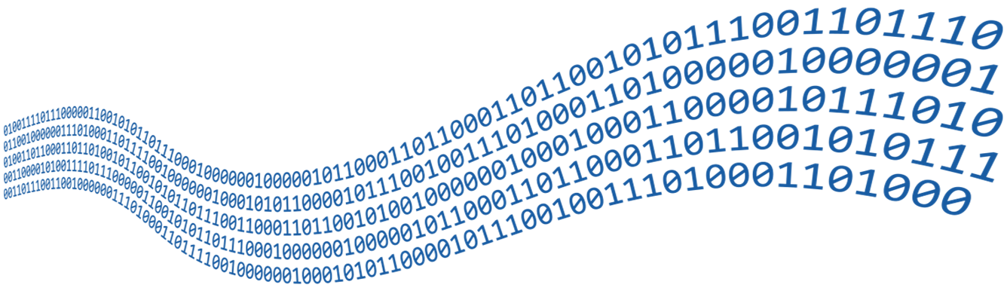
Streams, Files and Directories
File Types, Using Streams and Manipulating Files
SoftUni Team
Technical Trainers
Software University
https://softuni.bg

Slide 2

Table of Contents
What are Streams?
2. Readers and Writers
3. File Streams
4. File Class
5. Directory Class

Slide 3
Have a Question?
sli.do
#csharp-advanced

Slide 4

Streams: Basic Concepts
What are Streams?

Slide 5


What is a Stream?
In programming, streams are used to transfer data between two endpoints (apps / devices / programs)
Developers use a stream to:
Read (receive) data
Write (send) data
1100 1001 1001
Stream
5
Notes:
Icons by Chanut is Industries / Pixel perfect at http://www.flaticon.com/

Slide 6
Stream Basics
Streams are means for transferring (reading and writing) data
Example: downloading a file from Internet uses streams
Streams are ordered sequences of bytes
Provide sequential access to its elements (follow the FIFO rule)
Different types of streams are access different data sources:
File streams, network streams, memory streams and others
Typical use scenario: open a stream → read / write → close
Streams use buffering: data is sent and comes in chunks

Slide 7
Streams and Buffering – Example
Length = 9
Position is the current offset from the stream start
Buffer keeps n bytes of the stream from the current position
F i l e s a n d
46 | 69 | 6c | 65 | 73 | 20 | 61 | 6e | 64
Position
Buffer
46 | 69
6c | 65
73 | 20
61 | 6e
64

Slide 8
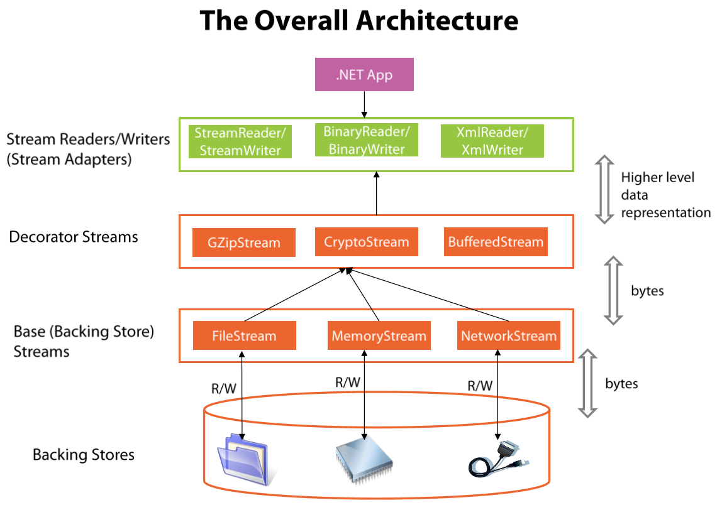
Stream Types in .NET

Slide 9

Text Readers and Writers
Readers and Writers in C#

Slide 10
Using StreamReader
StreamReader in C# reads text from a file / stream
The using(…) statement closes properly the stream at the end
var reader = new StreamReader(fileName);
using (reader)
{
// Use the reader here, e.g. string line = reader.ReadLine();
}

Slide 11
Example: Reading a Text File
Read the content from a text file input.txt
Print on the console each line number + line text (start from 1)
First line
Second Line
Third line
1. First line
2. Second Line
3. Third line

Slide 12
Example: Reading a Text File – C# Code
var reader = new StreamReader("../../../input.txt");
using (reader)
{
int counter = 1;
while (true)
{
string line = reader.ReadLine();
if (line == null)
break;
Console.WriteLine(++counter + ". " + line);
}
}

Slide 13
Using StreamWriter
StreamWriter in C# writes text to a file / stream
The using(…) statement closes properly the stream at the end
var writer = new StreamWriter(fileName);
using (writer)
{
// Use the writer here, e.g. writer.WriteLine("Some text");
}

Slide 14
Problem: Odd Lines
Read the content from a text file input.txt
Print the odd lines in a text file output.txt
Counting starts from 0
Two households, both alike in dignity, In fair Verona, where we lay our scene, From ancient grudge break to new mutiny, Where civil blood makes civil hands unclean.
In fair Verona, where we lay our scene,
Where civil blood makes civil hands unclean.

Slide 15
Solution: Odd Lines
var reader = new StreamReader("input.txt");
using (reader) {
int counter = 0;
string line = reader.ReadLine();
using (var writer = new StreamWriter("output.txt")) {
while (line != null)
if (counter % 2 == 1)
writer.WriteLine(line);
counter++;
line = reader.ReadLine();
}
}

Slide 16
Problem: Line Numbers
Read the text file input.txt
Insert a line number in front of each line of the file
Save the result in a text file output.txt
Two households, both alike in dignity, In fair Verona, where we lay our scene, From ancient grudge break to new mutiny, Where civil blood makes civil hands unclean.
1. Two households, both alike in dignity, 2. In fair Verona, where we lay our scene, 3. From ancient grudge break to new mutiny, 4. Where civil blood makes civil hands unclean.

Slide 17
Solution: Line Numbers
using (var reader = new StreamReader("input.txt"))
{
string line = reader.ReadLine();
int counter = 1;
using (var writer = new StreamWriter("output.txt"))
while (line != null)
{
writer.WriteLine($"{counter}. {line}");
line = reader.ReadLine();
counter++;
}
}

Slide 18
Open → Read → Close with Try-Catch-Finally
StreamReader reader = null;
int linesCount = 0;
try {
reader = new StreamReader("input.txt");
while (reader.ReadLine() != null)
linesCount++;
Console.WriteLine("Lines count: {0}", linesCount);
}
catch (Exception ex) {
Console.Error.WriteLine("Error reading file: {0}", ex);
}
finally {
if (reader != null) reader.Close();
}
Instead of try-finally, you can use using(reader)

Slide 19

Base Streams in .NET
System.IO.Stream

Slide 20
The System.IO.Stream Class
The base class for all streams is System.IO.Stream
Provides the basic read / write functionality
Read(buffer), Write(buffer, offset, count)
Some streams do not support read, write or positioning operations
Properties CanRead, CanWrite and CanSeek are provided
Streams which support positioning, have also the properties Position and Length

Slide 21
Methods of System.IO.Stream Class (1)
int Read(byte[] buffer, int offset, int count)
Read as many as count bytes from input stream, starting from the given offset position
Returns the number of read bytes or 0, if end of stream is reached
Can freeze for undefined time while reading at least 1 byte
Can read less than the claimed number of bytes
F i l e s a n d
46 | 69 | 6c | 65 | 73 | 20 | 61 | 6e | 64

Slide 22
Methods of System.IO.Stream Class (2)
Write(byte[] buffer, int offset, int count)
Writes a sequence of count bytes to an output stream, starting from the given offset position
Can freeze for undefined time, until it sends all bytes to their destination
Flush()
Sends the internal buffers data to its destination (data storage, I/O device, etc.)

Slide 23
Methods of System.IO.Stream Class (3)
Close()
Calls Flush()
Closes the connection to the device (mechanism)
Releases the used resources
Seek(offset, SeekOrigin)
Moves the position (if supported) with given offset towards the beginning, the end or the current position

Slide 24

File Streams
Reading / Writing Binary Files

Slide 25
File Streams
File streams reads / writes sequences of bytes from a file
Creating a new binary file:
Opening an existing file
using (var fs = new FileStream("file.bin", FileMode.Create))
{
// Write to the file: fs.Write(byte[]) …
}
using (var fs = new FileStream("file.bin", FileMode.Open))
{ // Read from file or write to the file … }

Slide 26
Writing Text to File – Example
string text = "Кирилица";
var fileStream =
new FileStream("log.txt", FileMode.Create);
using(fileStream)
{
byte[] bytes = Encoding.UTF8.GetBytes(text);
fileStream.Write(bytes, 0, bytes.Length);
}
Encoding.UTF8.GetBytes() returns the underlying bytes of the characters

Slide 27
Encrypt / Decrypt File with XOR
using (var fin = new FileStream("example.png", FileMode.Open))
using (var fout = new FileStream("example-encrypted.png", FileMode.Create))
{
byte[] buffer = new byte[4096];
while (true)
{
int bytesRead = fin.Read(buffer);
if (bytesRead == 0) break;
const byte secret = 183;
for (int i = 0; i < bytesRead; i++)
buffer[i] = (byte) (buffer[i] ^ secret);
fout.Write(buffer, 0, bytesRead);
}
}
Encrypting the read bytes with the constant parameter secret using XOR operator
https://gist.github.com/nakov/1d39c4513cff83b8a735d7dc883dfe18

Slide 28


.NET API for Easily Working with Files
File Class in .NET

Slide 29
Reading Text Files
File.ReadAllText() → string - reads a text file at once
File.ReadAllLines() → string[] - reads a text file's lines
using System.IO;
…
string text = File.ReadAllText("file.txt");
using System.IO;
…
string[] lines = File.ReadAllLines("file.txt");

Slide 30
Writing Text Files
Writing a string to a text file:
Writing a sequence of strings to a text file, at separate lines:
Appending additional text to an existing file:
File.WriteAllText("output.txt", "Files are fun :)");
string[] names = { "peter", "irina", "george", "mary" };
File.WriteAllLines("output.txt", names);
File.AppendAllText("output.txt", "\nMore text\n");

Slide 31
Reading / Writing Binary Files
Writing a byte[] to a text file:
Reading a binary file into byte[]:
using System.IO;
…
byte[] bytesToWrite = { 0, 183, 255 };
File.WriteAllBytes("output.txt", bytesToWrite);
using System.IO;
…
byte[] bytesRead = File.ReadAllBytes("binaryFile.txt");

Slide 32

.NET API for Working with Directories
Directory Class in .NET

Slide 33
Basic Directory Operations
Creating a directory (with all its subdirectories at the specified path), unless they already exists:
Deleting a directory (with its contents):
Moving a file or a directory to a new location:
Directory.CreateDirectory("TestFolder");
Directory.Delete("TestFolder", true);
Directory.Move("Test", "New Folder");

Slide 34
Listing Directory Contents
GetFiles() - returns the names of the files in the specified directory (including their paths)
GetDirectories() - returns the names of the subdirectories (including their paths) in the specified directory
string[] filesInDir = Directory.GetFiles("TestFolder");
string[] subDirs = Directory.GetDirectories("TestFolder");

Slide 35
Problem: Calculate Folder Size
You are given a folder named TestFolder
Calculate the size of all files in the folder (with its subfolders)
Print the result in a file "output.txt" in megabytes
output.txt
5.16173839569092

Slide 36
Solution: Calculate Folder Size
double sum = 0;
DirectoryInfo dir = new DirectoryInfo("TestFolder");
FileInfo[] infos = dir.GetFiles("*", SearchOption.AllDirectories);
foreach (FileInfo fileInfo in infos)
{
sum += fileInfo.Length;
}
sum = sum / 1024 / 1024;
File.WriteAllText("оutput.txt", sum.ToString());
Gets all files from the given folder and its subfolders

Slide 37
Summary
…
…
…
Streams are ordered sequences of bytes
Operations: open → read / write → close
Always close streams with try-finally or using(…)
Use StreamReader / StreamWriter for text data
Use FileStream to read / write binary files
Use the File class to read / write files at once
Use the Directory class to work with directories

Slide 38
Questions?
Notes:
38

Slide 39












SoftUni Diamond Partners

Slide 40


Educational Partners

Slide 41
Trainings @ Software University (SoftUni)
Software University – High-Quality Education, Profession and Job for Software Developers
softuni.bg, about.softuni.bg
Software University Foundation
softuni.foundation
Software University @ Facebook
facebook.com/SoftwareUniversity
Software University Forums
forum.softuni.bg
41
Notes:
41

Slide 42

License
This course (slides, examples, demos, exercises, homework, documents, videos and other assets) is copyrighted content
Unauthorized copy, reproduction or use is illegal
© SoftUni – https://about.softuni.bg/
© Software University – https://softuni.bg
Notes:
42

